Slide 1
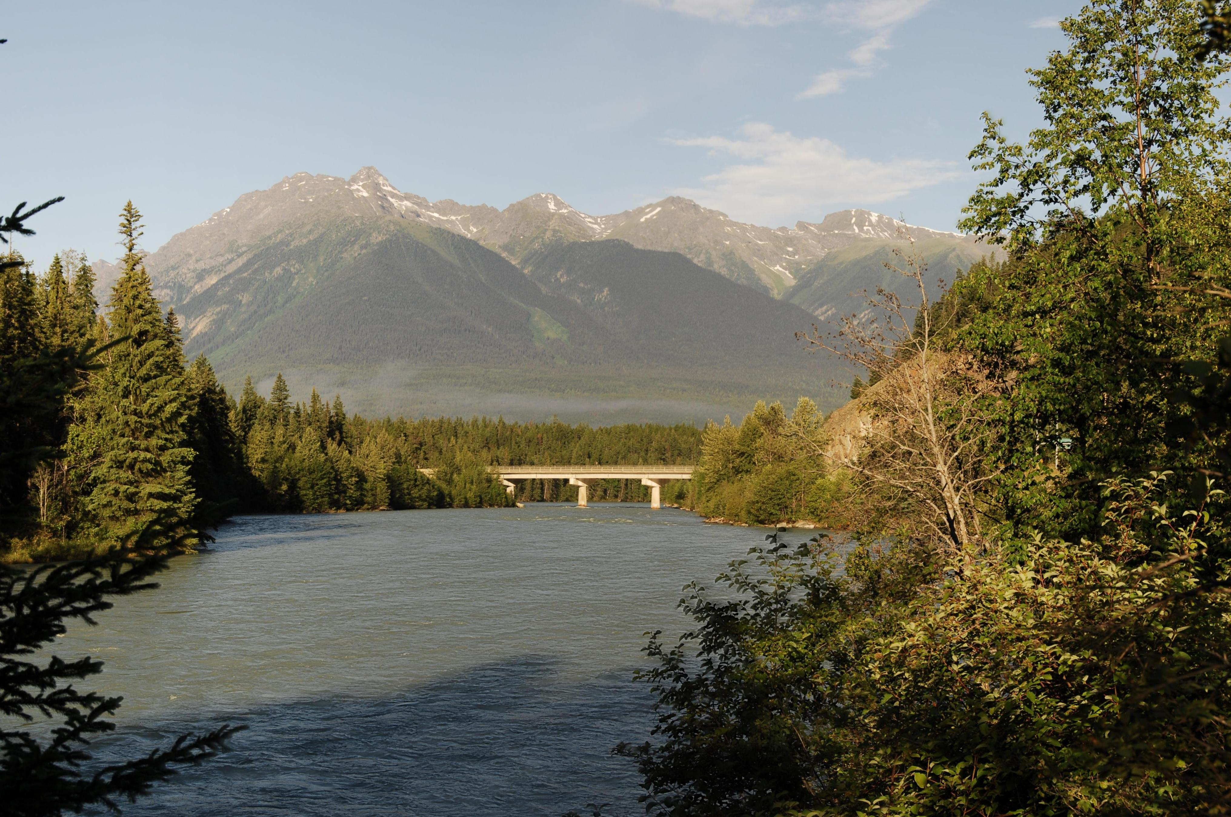

A Snapshot in Time
Prepared for:
Prince George FREP Overview
October 16th 2012
Jacques Marc RFT
Visual Resource Management Officer
Resource Practices Branch
Luc Roberge RPF
Visual Resource Specialist
Omineca, Skeena, Northeast Regions

Slide 2

Visual Effectiveness Evaluation
What is it?
It is a process and set of criteria used to determine whether established visual quality objectives (VQO’s) are being achieved.
Role:
Its role is to provide information on resource status/trends, which in turn will identify if forest legislation, policies and practices are working.
2

Slide 3
FREP Evaluation vs C&E Inspection
FREP
Multiple samples necessary.
Openings chosen randomly.
Evaluates trends over time.
Reporting out looks at what action is needed to improve practices.
Evaluation procedure similar to inspection.
Numerical assessment has equal weight to ocular assessment.
Evaluations could alert C&E to potential issues.
C&E Inspection
Generally a single sample.
Openings are targeted.
Evaluates compliance with VQO.
Reporting out may lead to an investigation and penalties.
Inspection procedure similar to evaluation.
Numerical assessment supports ocular assessment.
Inspections could contribute to FREP sampling.
3

Slide 4

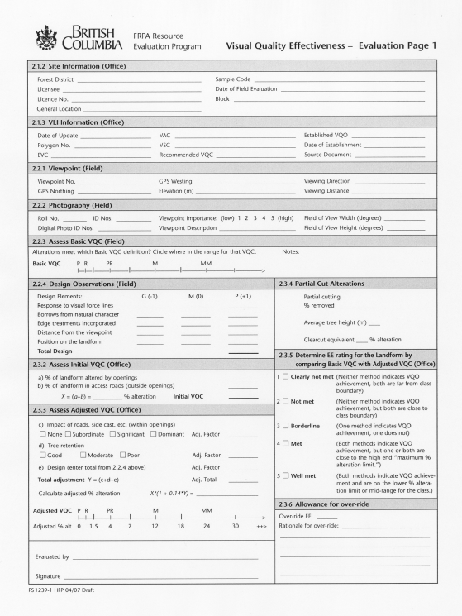
Visual Effectiveness Evaluation
Draft procedures & standards document released July 2004 & revised in 2005.
Published in 2008.
The Visual Protocol was developed to be applied to a single block or multiple blocks visible from a significant public viewpoint.
FREP data collection is conducted at the district level, but the results can be rolled up at any level (licensee, district, region, area, & provincially).
4

Slide 5
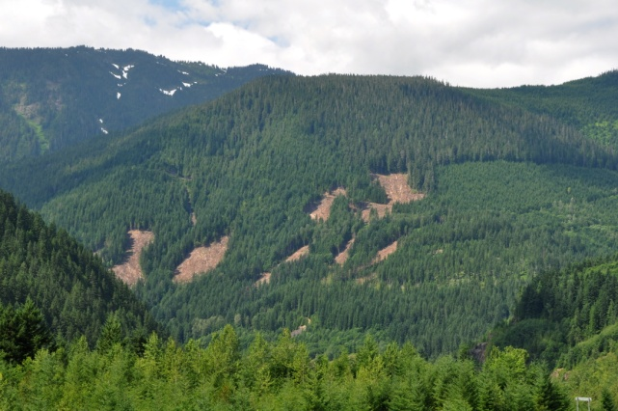
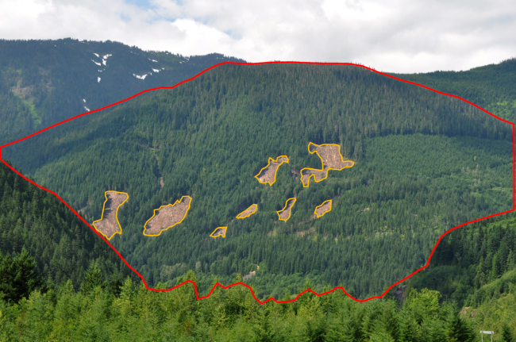
Visual Evaluation Procedures
The visual evaluation approach assesses landscape using two
independent measures:
an ocular assessment is used to evaluate the basic definition for each category of alteration (VQO) and;
the perspective percent alteration and design elements are assessed using standards and criteria derived through research.
The two measures are combined to
Determine a final rating.
4.2% Alt
5

Slide 6
Visual Evaluation Procedures
The Forest Planning and Practices Regulation S.1.1 defines 5 categories of alteration:
  - Preservation
  - Retention
  - Partial Retention
  - Modification
  - Maximum Modification
The final EE rating for VQO achievement are expressed as follows:
  Clearly not met
  Not met
  Borderline
  Met
  Well Met
6

Slide 7
Progress To Date
Between 2006 and 2008 the FREP program randomly sampled 234 visual openings harvested under the Code.
Extension Note #13 was released in 2010 summarizing the results of the Code sampling provincially.
In 2008 FREP began sampling FRPA (FSP) openings across the province to determine the effectiveness of managing visuals under FRPA.
Visuals were added to the FREP mandatory list in 2009 and the goal is to sample 20 FRPA landscapes per district by 2012.
To-date, provincially we have 221 samples.
7

Slide 8
What did we learn about
Visual Management
Under the Code?
8

Slide 9
Code - Omineca Results
1. To what extent were VQOs being achieved under the Code?
Provincially VQO’s achieved
61% of the time.
Omineca ( DPG,DVA, DJA & DMK) VQOs
achieved 56% of the time.
Omineca results are slightly behind provincial average
9

Slide 10
2. Did VQO achievement vary by VQO class?
Code - Omineca Results
Code Results by VQO (n=43)
R
PR
M
MM
Retention VQOs were achieved 33% of the time provincially.
PR VQOs were achieved 63% of time provincially.
Retention VQOs were achieved 44 % of the time in Omineca under the Code.
PR VQOs were achieved 67% of the time in Omineca under the Code.
Omineca results slightly better than provincial average
10

Slide 11
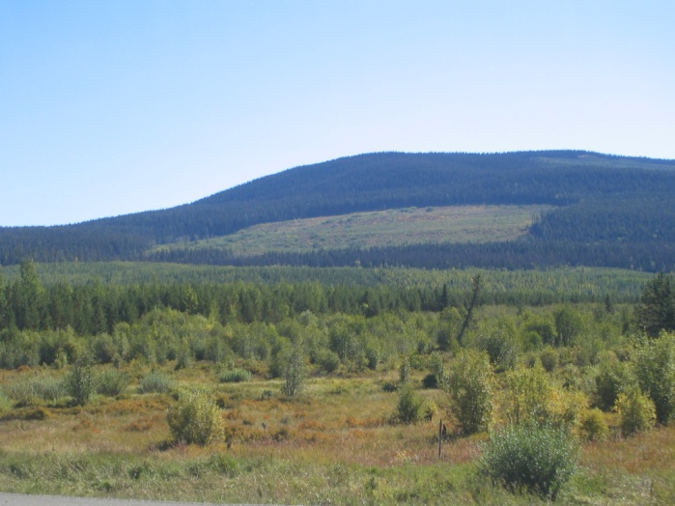
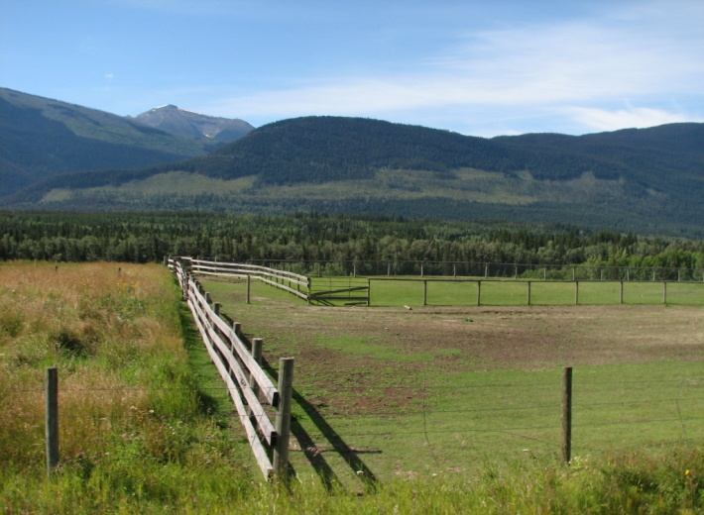
Code - Omineca Results
3. To what extent were visual design concepts and principles being applied in harvest planning?
Poor Design
Good Design
Omineca results slightly better than provincial result.
11

Slide 12
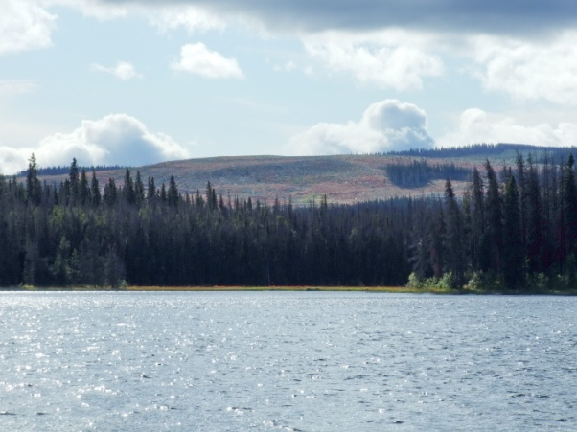
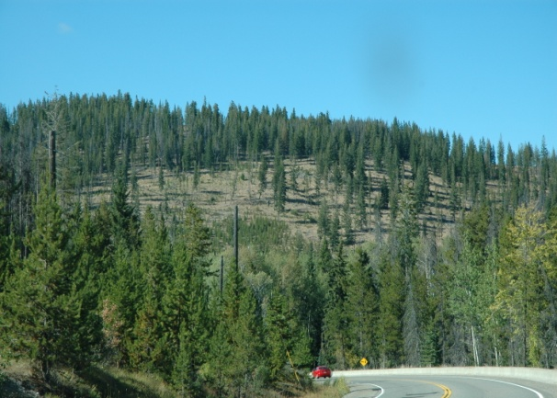
Code - Omineca Results
4. What levels of tree retention are being implemented within harvest openings to achieve VQOs?
Tree Retention Code Omineca (N=43)
In-effective Retention
Effective Retention
(Poor = 15%<, Moderate 15%-22% ,Good 22% +)
Omineca openings proportionately contained more retention.
12

Slide 13
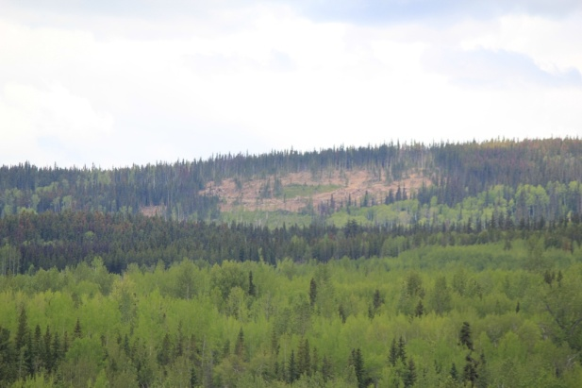
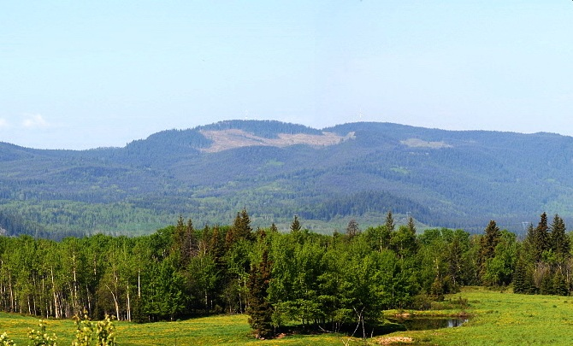
Code - Omineca Results
5. How effective were the different silvicultural systems at achieving VQOs?
Code Results
VQOs were more likely to be achieved using clear cuts 62% provincially under the Code. Omineca results very similar at 64%.
13

Slide 14
Observations
VQOs were achieved 61% of the time provincially under the Code. (Omineca 56%)
The most restrictive VQOs (Retention and Partial Retention) were at greatest risk for non achievement. (Omineca results were consistent with this trend.)
The Retention VQO was achieved less than half the time. There is a need to modify and/or change strategies for managing on these sensitive landscapes.
Forest alterations in scenic areas exhibited good visual design 40% of the time. (Omineca 44%) There is room for improvement.
Visually effective levels of tree retention were present in 22% of the openings sampled. (Omineca 43%) Provincially, the majority of samples did not contain enough retention to offset the dominance of block size.
14

Slide 15
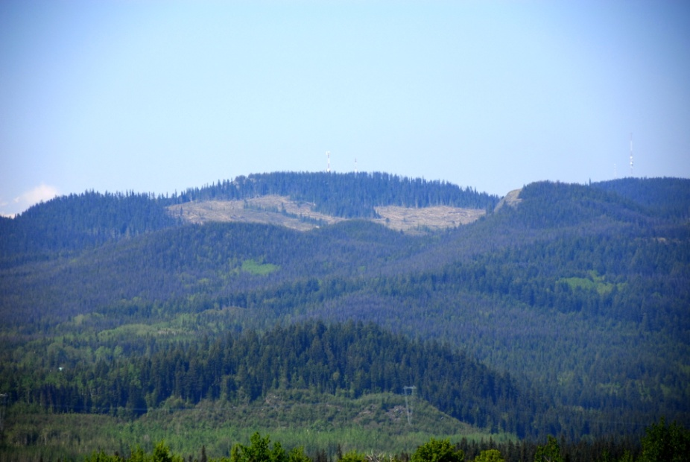
Provincial Results Code Vs FRPA
To date 221 FRPA samples
have been entered into the
FREP database and
analysed.
Preliminary graphs showing
results to date have
been produced.
15

Slide 16
Provincial Results Code vs FRPA
1. To what extent are VQOs being achieved under FRPA?
Code Results
FRPA Results
Provincially VQO’s were achieved on average 61% of the time.
Practices consistent with VQO’s 66% of the time.
FRPA has resulted in a 5% Improvement in achieving VQOs.
16

Slide 17
Provincial Results Code vs FRPA
2. Does VQO achievement vary by VQO class?
Code Results
FRPA Results
R VQOs achieved 33% under Code 43% under FRPA.
PR VQOs achieved 63% under Code, 64% under FRPA.
Slight improvement in R category, no improvement in PR category.
17

Slide 18
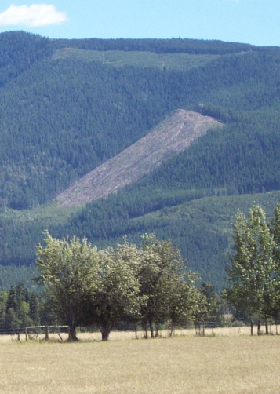
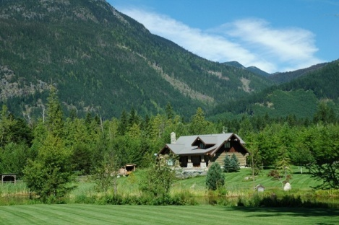
Provincial Results Code vs FRPA
3. To what extent are visual design concepts and principles being applied in harvest and road planning?
Code Results
Poor Design
Good Design
Under Code good visual design evident 40% of the time. Under FRPA good visual design evident 39% of the time.
18

Slide 19
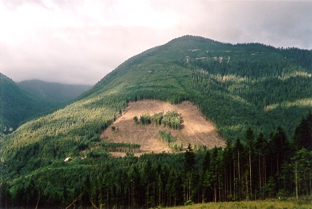
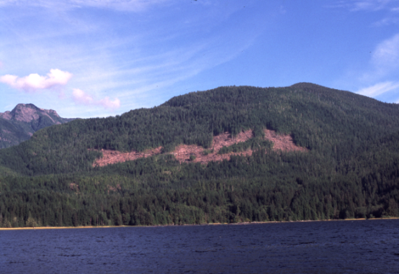
Provincial Results Code vs FRPA
4. What levels of tree retention are being implemented within harvest openings to achieve VQOs?
(Poor = 15%<, Moderate 15%-22% ,Good 22% +)
In-effective Retention
Effective Retention
The proportion of openings containing good or moderate amounts of retention has dropped significantly.
19

Slide 20
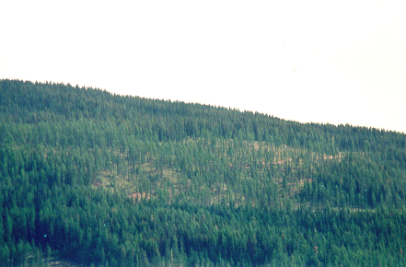
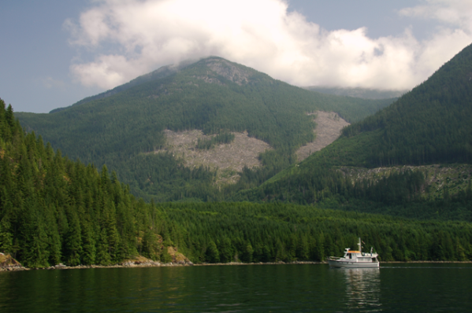
Provincial Results Code vs FRPA
5. How effective are the various silvicultural systems at achieving VQOs?
Code Results
FRPA Results
VQOs were more likely to be achieved using clear cuts under Code.
VQOs are more likely to be achieved using partial cuts under FRPA.
20

Slide 21
Preliminary Observations
A preliminary analysis of FRPA openings (N=221) shows very little improvement in the management of visual quality under FRPA vs the Code.
Retention VQOs are being achieved at a slightly higher rate 43% under FRPA as opposed to 33% under Code.
No appreciable improvement in PR achievement. (was 63% now 64%)
Visual design has not improved and remains an area in need of improvement.
The proportion of openings containing good and moderate amounts of in block tree retention has dropped significantly.
21

Slide 22
Where from Here?
Enter FREP samples collected in 2012 and report out provincially and regionally in spring of 2013.
Identify continuous improvement opportunities to professionals such as; use of visual design techniques to create more natural looking openings, use of more partial cutting and retention to retain higher levels of volume, or stems, within harvested openings, use of smaller opening sizes in retention and partial retention VQO areas.
Provide recommendations to MFLNRO Executive on how to improve Visual Management. For example there is a need to amend the FPPR to define terms such as significant public viewpoint and landform.
Update the VIA Guidebook as Best Management Practice.
Provide Visual Resource Management training to Professionals.
22

Slide 23
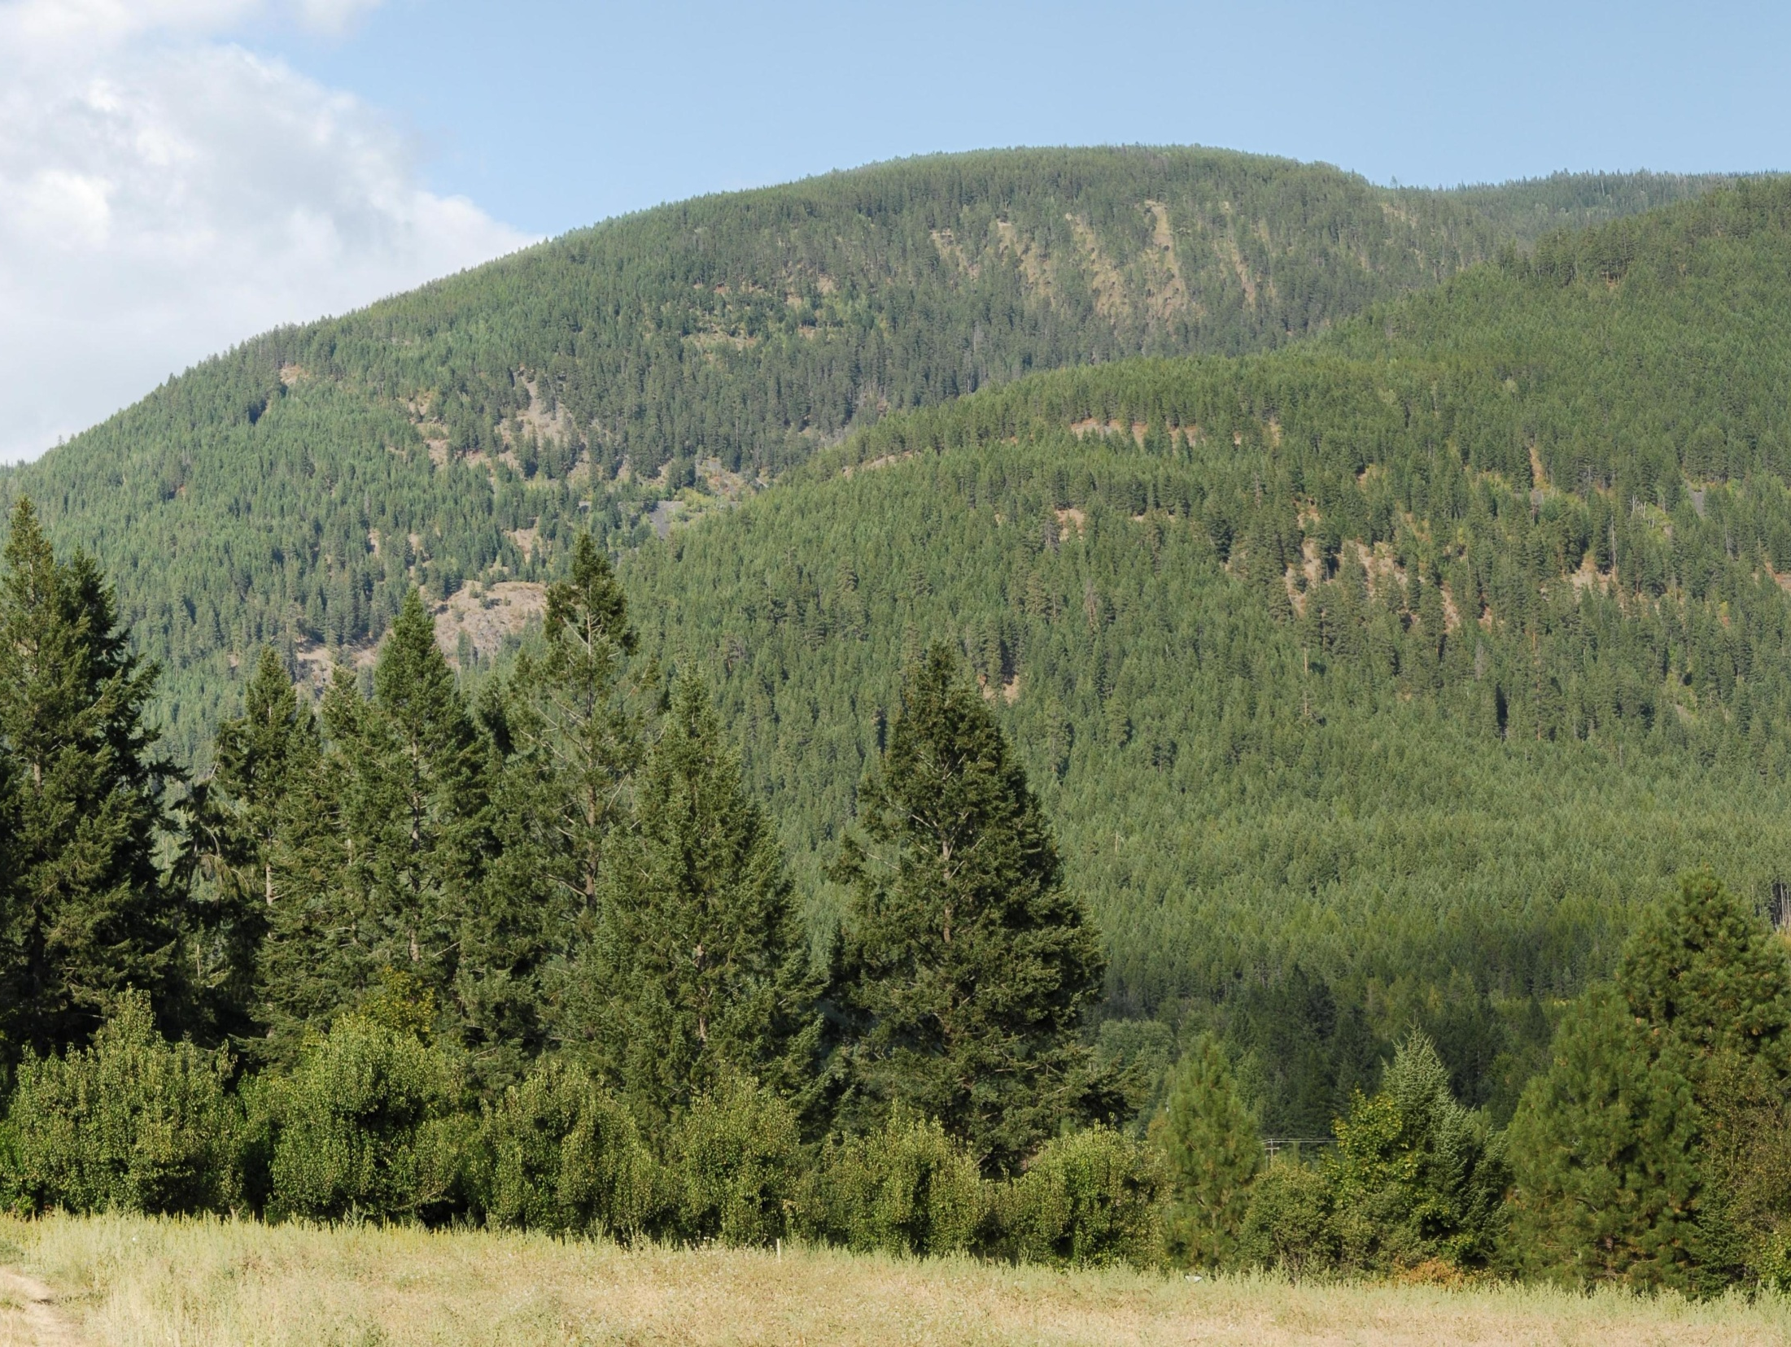
Thank You
Ministry of
Forests, Lands and
Natural Resource Operations
23

